Slide 1
Charge Quantization
Charge cannot take any arbitrary values, but only values that are integral multiples of the fundamental charge (charge of proton/electron).
Quarks charge (fractional)

Slide 2
Charge Quantization
How many electrons would have to be removed from a coin to leave it with a charge of 1.0 x10⁻⁷ C?
Charge on particles is quantized, so the charge on a particle q is equal to some number of electrons n times the magnitude of the charge of a single electron.

Slide 3
Charge Quantization
Two tiny, spherical water drops, with identical charges of 1.00x10⁻¹⁶ C, have a center-to-center separation of 1.00 cm. (a) What is the magnitude of the electrostatic force acting between them? (b) How many excess electrons are on each drop, giving it its charge imbalance?
8.99x10⁻¹⁹N
625e

Slide 4
Charge Quantization
What is the magnitude of the electrostatic force between a singly charged sodium ion (Na⁺, of charge ⁺e) and an adjacent singly charged chlorine ion (Cl⁻, of charge ⁻e) in a salt crystal if their separation is 2.82x10⁻¹⁰ m?

Slide 5
Charge Quantization
The magnitude of the electrostatic force between two identical ions that are separated by a distance of 5.0x10⁻¹⁰ m is 3.7x10⁻⁹ N. (a) What is the charge of each ion? (b) How many electrons are “missing” from each ion (thus giving the ion its charge imbalance)?

Slide 6
Charge Quantization
A current of 0.300 A through your chest can send your heart into fibrillation, ruining the normal rhythm of heartbeat and disrupting the flow of blood (and thus oxygen) to your brain. If that current persists for 2.00 min, how many conduction electrons pass through your chest?

Slide 7
Charge Conservation
Electrons and positrons are produced by the nuclear transformations of protons and neutrons known as beta decay.
(a) If a proton transforms into a neutron, is an electron or a positron produced?
(b) If a neutron transforms into a proton, is an electron or a positron produced?

Slide 8
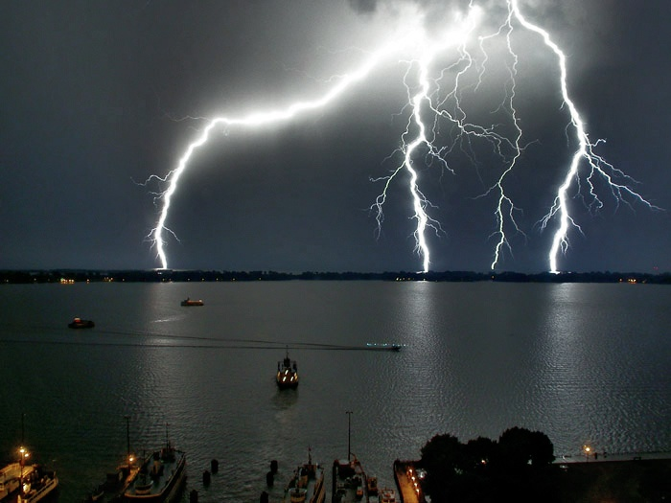
Electric Field

Slide 9
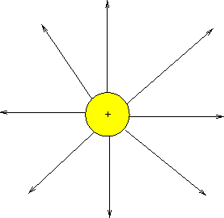
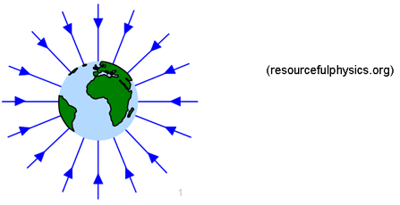
Analogy
The electric field is the space around an electrical charge
just like
a gravitational field is the space around a mass.

Slide 10
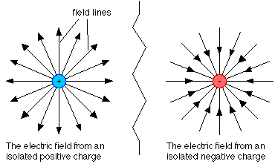
Electric Field
Space around a charge.

Slide 11
What is the difference?

Slide 12
Electric Field Vector, E
Electric Field is designed as follows
E = F/ q_{o}
q_{o ,} positive test charge
E is a vector quantity
  Direction indicated by small + test charge
Unit: N/C
E is analogous to the gravitational field, g, where g=F/m
Notes:
The electric field is a vector field; it consists of a distribution of vectors, one for each point in the region around a charged object, such as a charged rod. In principle,
we can define the electric field at some point near the charged object, such as point P as follows: We first place a positive charge q0, called a test
charge, at the point. We then measure the electrostatic force that acts on the test charge. Finally, we define the electric field at point P due to the charged object as

Slide 13
Example 1
A charge of 3µC is used to test the electric field of a central charge of 6C that causes a force of 800N. What is the magnitude of the electric field?
Hint… Which charge ‘tests’ the field
Answer: 2.7 x10⁸ N/C

Slide 14
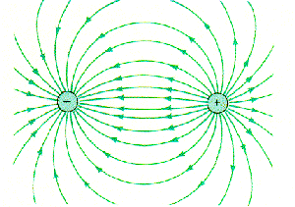
Electric Field Lines

Slide 15
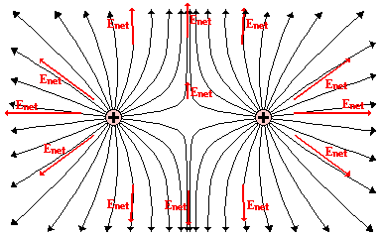
Electric Field Lines of two Positive Charges

Slide 16
Electric Field Lines
Michael Faraday introduced the idea of electric fields in the 19th century
The space around a charged body as filled with lines of force called electric field lines
Although we no longer attach much reality to these lines
Still provide a nice way to visualize patterns in electric fields
Notes:
A tangent line is a line that touches a curve at a single point and does not cross through it.

Slide 17
Electric Field Lines
The relation between the field lines and electric field vectors is:
At any point, the direction of a straight field line or the direction of the tangent to a curved field line gives the direction of at that point

Slide 18
Electric Field Lines
2. the field lines are drawn so that the number of lines per unit area, measured in a plane that is perpendicular to the lines, is proportional to the magnitude of E.Thus, E is large where field lines are close together and small where they are far apart.

Slide 19
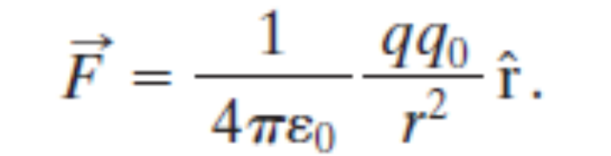
The Electric Field Due to a Point Charge
To find the electric field due to a point charge q at any point a distance r from the point charge, we put a positive test charge q0 at that point.
From Coulomb’s law the electrostatic force acting on q0 is

Slide 20
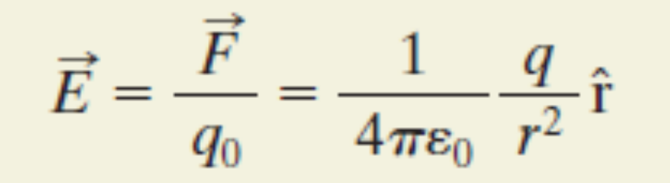
The Electric Field Due to a Point Charge
direction of E is the same as that of the force on the positive test charge:
directly away from the point charge if q is positive, and toward it if q is negative.

Slide 21
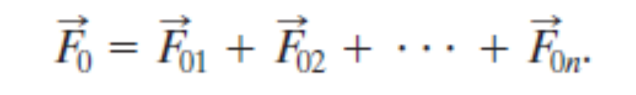
The Electric Field Due to a Point Charge
If we place a positive test charge q0 near n point charges q1, q2, . . . , qn, then, the net, or resultant, electric field due to more than one point charge.

Slide 22
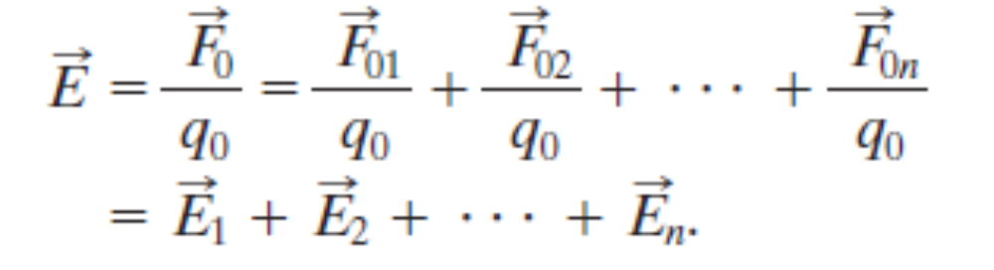
The Electric Field Due to a Point Charge
Therefore, the net electric field at the position of the test charge is
It shows that the principle of superposition applies to electric fields as well as to electrostatic forces
Notes:
states that, for all linear systems, the net response caused by two or more stimuli is the sum of the responses that would have been caused by each stimulus individually.

Slide 23
Problem
Three particles with charges q=+2Q, Q2=-2Q, and q3=-4Q, each a distance d from the origin. What net electric field is produced at the origin?

Slide 24
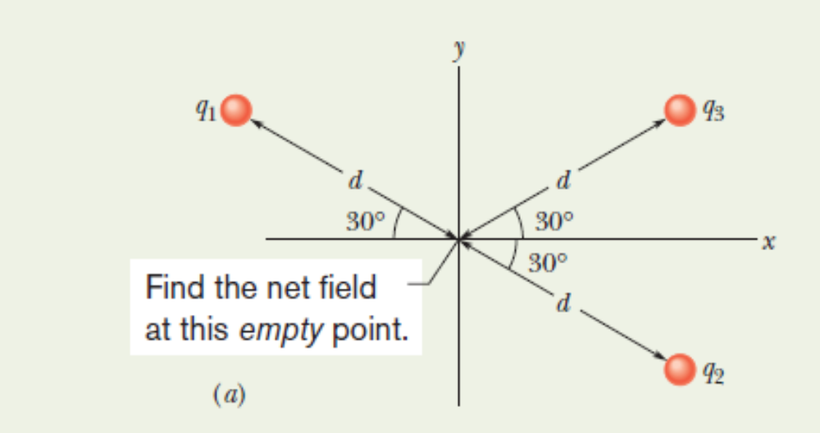
Problem

Slide 25
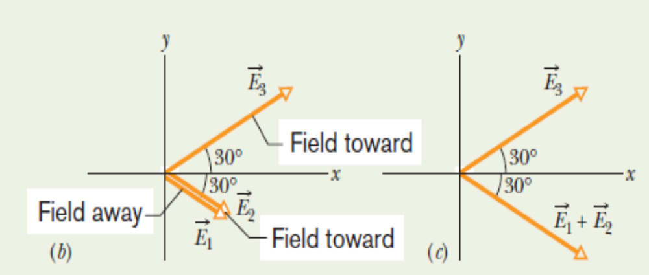
Problem

Slide 26
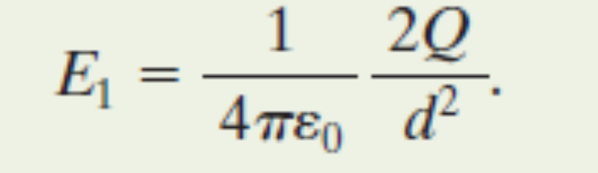
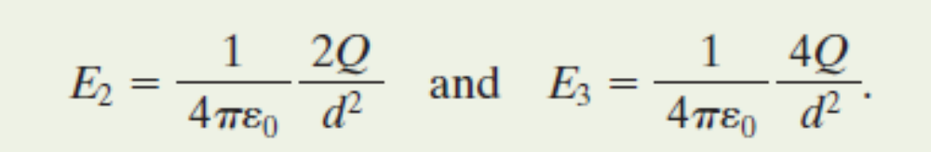
Solution

Slide 27
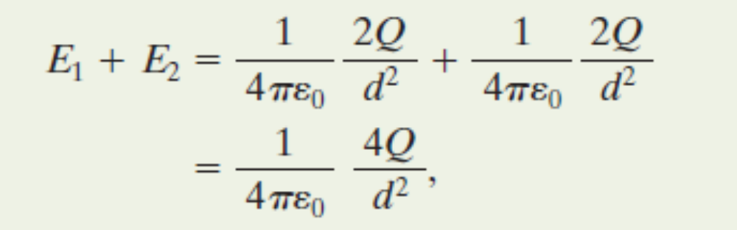
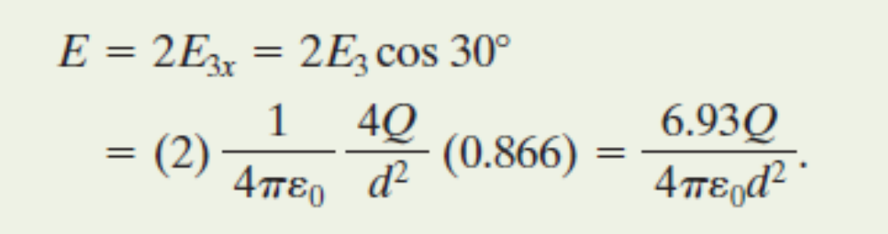
Solution

Slide 28
Where are you safe during a thunderstorm?
In a car or
Outdoors

Slide 29
Where are you safe during a thunderstorm?
In a car or
Outdoors

Slide 30
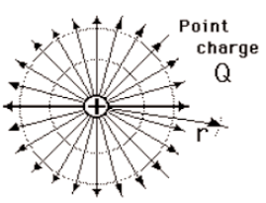
Which field is stronger?
A B

Slide 31
Which field is stronger?
A B

Slide 32
Electric Field for a Point Charge
Using E=F/q_{o} and Coulomb’s Law prove:
E = k Q
______
r²
where Q is the central charge.

Slide 33
Example 2
A test charge of +3µC is located 5m to the east of a -4µC charge.
A) Find the electric force felt by the test charge.
B) Find the electric field at that location.
Answer: 4.32x10⁻³ N, 1.44 x 10³ N/C along the –x axis.

Slide 34
Example 3
If a test charge is moved to a location three times as far as its original location, how does the electric field change?
Inverse-Square Law says… 1/9

Slide 35
Example 4
Calculate the electric field felt by a positive test charge located half way between a charge of +1C and a charge of -3C, that are 2m apart.
Answer: 3.6 x 10¹⁰ N/C (toward the -3C charge)

